Slide 1
SR Bricks and demand elasticity
Group 7

Slide 2
Aim of Project
To analyze month-wise demand of bricks in year 2015.
The analysis includes cost price, selling price, quantity sold, net profit and demand elasticity of bricks.

Slide 3
What is Demand Elasticity?
It is the ratio of ‘change in quantity demanded’ to ‘change in price’.
Demand elasticity Ed =
Change in Demand
Change in Price

Slide 4
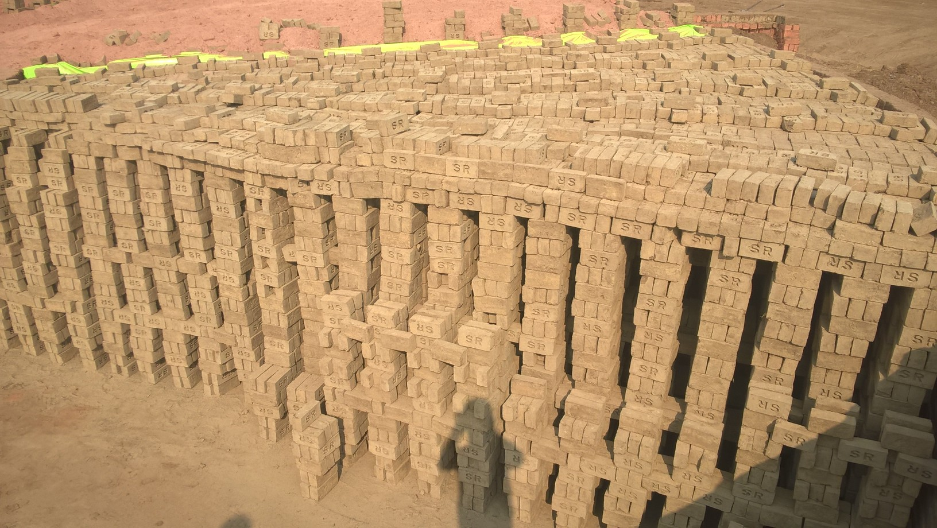
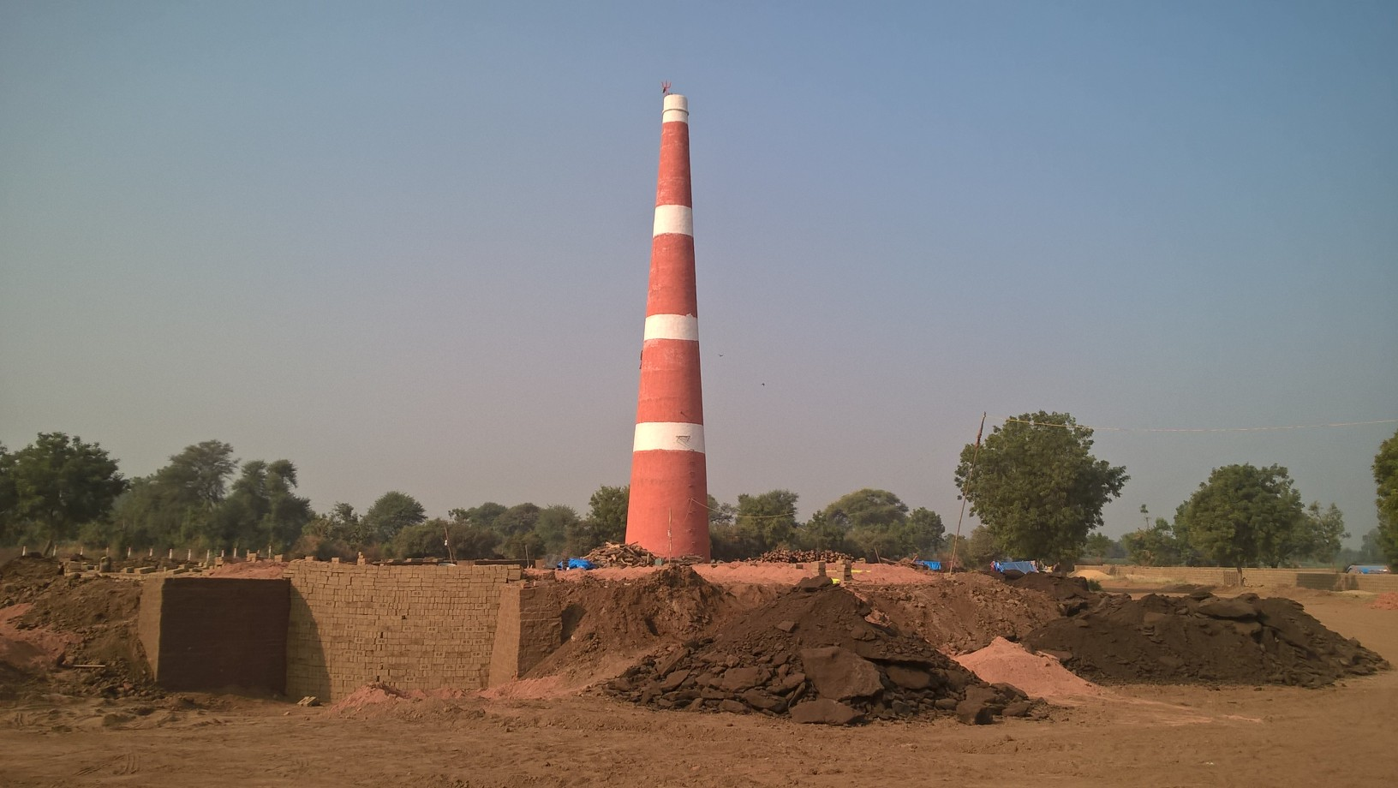
Location - Gandhinagar

Slide 5
Bricks Distribution
It is a contract based business.
Usually customers include private builders, small traders etc.
The quantity of bricks demanded depends on contract and varies from around 50000 to 150000 per month.

Slide 6
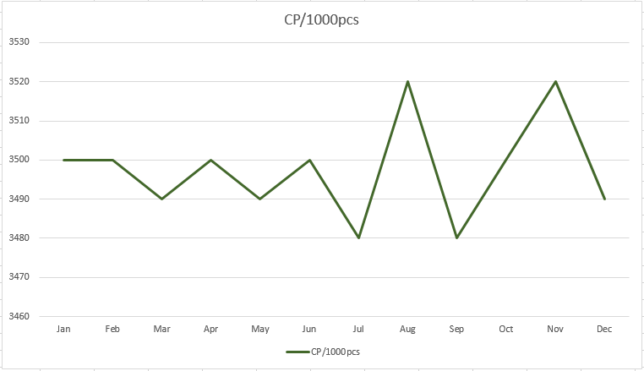
Cost Price – 1000 pcs

Slide 7
Cost Price
The cost price is observed to be maximum in August and November.
This infers that during onset of monsoon and winter season the price of raw materials are high.

Slide 8
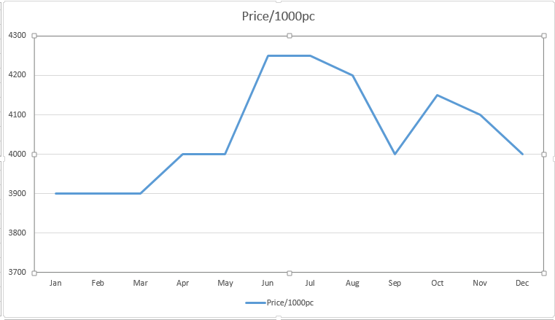
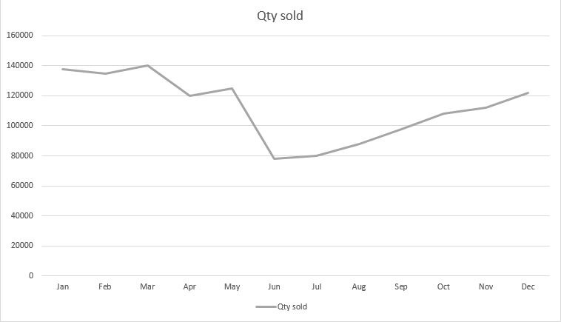
Price - 1000 pcs and total quantity sold

Slide 9
Effect of Monsoon on Price
Usually the demand goes low during monsoon.
The big private builders demand bricks all throughout the year. Rainy season plays little role in their demand.
While the demand from small traders is drastically reduced during monsoon.

Slide 10
Effect of Monsoon on Price
The price is usually set(by owner) so as to maintain the net income. Accordingly profits are set.
The quantity demanded was minimum in June. Thus the price was observed to be maximum in the same month to balance the income.

Slide 11
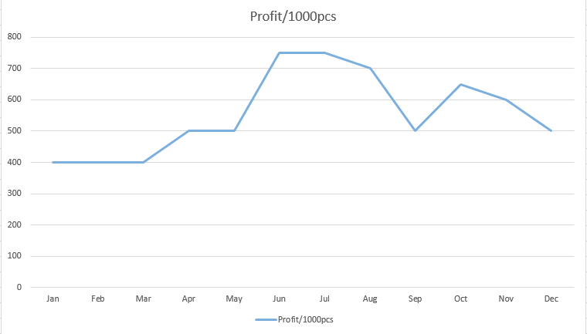
Profit – 1000 pcs

Slide 12
Profit
The profit is constant in the first three months, then it gradually increases till July and decreases thereafter.
Apparent reason for the decrease in price after July is the increasing demand.
The profit is maximum in the months of Rainy season.

Slide 13
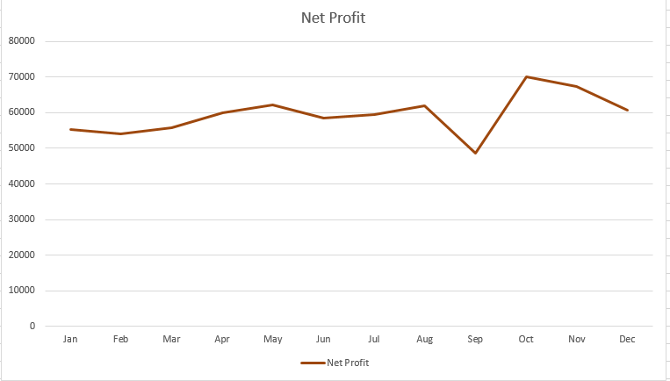
Net Profit

Slide 14
Net Profit
As expected, the net profit remains almost constant throughout the year.
This explains that the trader maintains his net income regardless of the quantity demanded.

Slide 15
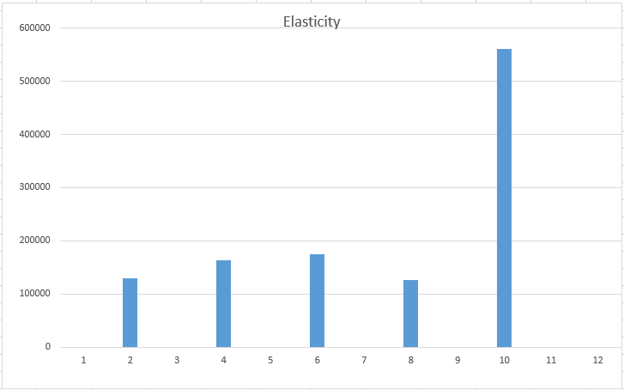
Demand Elasticity

Slide 16
Demand Elasticity
Month | Demand Elasticity
(Jan-Feb) – (March-April) | 130000
(March-April) – (May-Jun) | 162857
(May-Jun) – (July-Aug) | 175000
(July-Aug) – (Sep-Oct) | 126666
(Sep-Oct) – (Nov-Dec) | 560000

Slide 17
Demand Elasticity
Why did we compute the demand elasticity every two months?
Initially the idea was to calculate the elasticity every month. But approaching it that way would have made the denominator zero and the ratio would be infinity!
Thus to avoid that ambiguity, the average values over two months were considered.
The elasticity computed for the last four months is very high. Thus, the product is highly elastic during that time.

Slide 18
Mind Map
Processed Bricks
Monsoon
Processing
Raw Materials
Drastic Reduction in Demand
Sets Price
Less decrease in demand
Buys
Tries to Balance Net Income
Small Traders
Big Private Builders
Owner
Low Demand
High Demand
High Price
Net Income Balanced
Low Price

Slide 19
Conclusion
The production of bricks is generally done in the time when atmosphere is dry
In rainy season the quantity sold is low which is clear from the graph of quantity sold.
The revenue R = P (Price) * Q (Quantity sold) remains constant throughout the year.
The elasticity curve shows that in the last four months the ratio of change in quantity to change in price is very high i.e. a small change in one of these factors would produce a significant change in demand.
Demand of bricks is maximum in the period from winter to Summer as construction is more favorable in dry season.

